Slide 1

Hierarchical Neural Network Deep Learning CS230 Project
Suresh Sugumar
ssugumar@stanford.edu

Slide 2
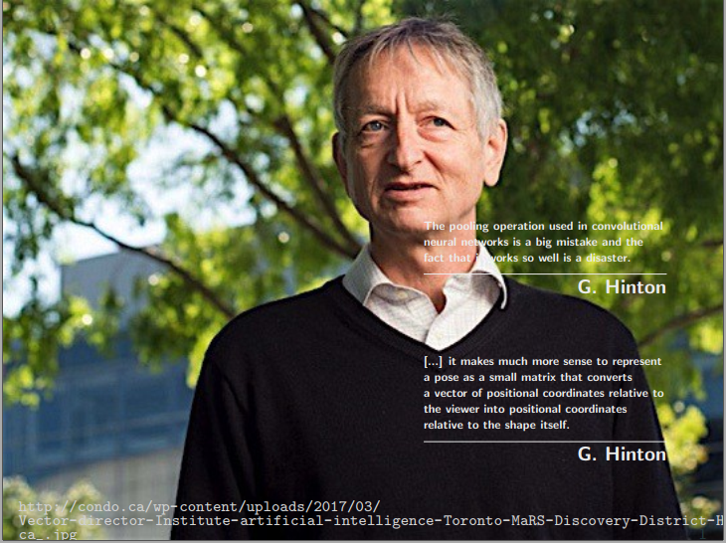
Motivation

Slide 3
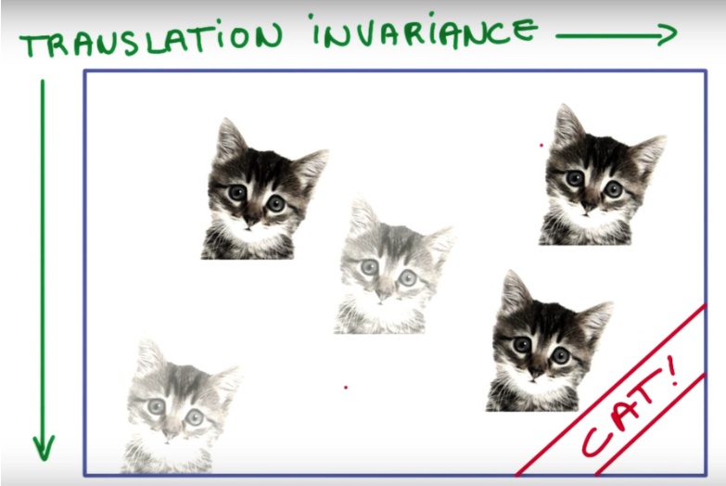
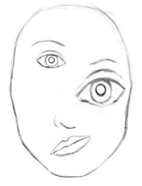
Drawbacks of CNN Architecture
Pooling layers (max pooling) results in poor translational invariance
Looses lot of valuable information during pooling
Ignores relation between the parts and the whole
To improve the translational invariance of CNN
Train network with lots of augmented data
Inefficient and waste of time and resources
But does not solve the problem completely
(source)
CNN
A human face
(Is fooled easily)

Slide 4
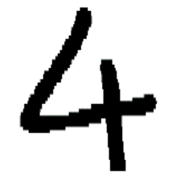

Goal of this Project
Build a neural network that is as good as CNN plus has translational invariance qualities
Current CNN Predictions
CNN
4
4
4
*
4
*
*
4
4
4
NEW
Not 4
4
4
4
4
4
4
4
x
x
x
Desired Predictions

Slide 5
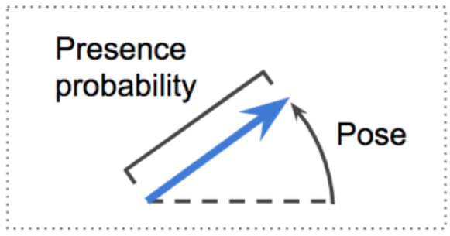
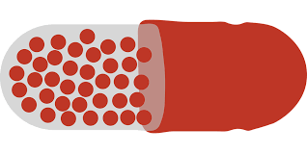
Capsules
A capsule is a group of neurons whose activity vector represents the instantiation parameters of a specific type of entity such as an object or an object part.
Hierarchical Neural Network based on Capsules
Output Vector
Capsule

Slide 6
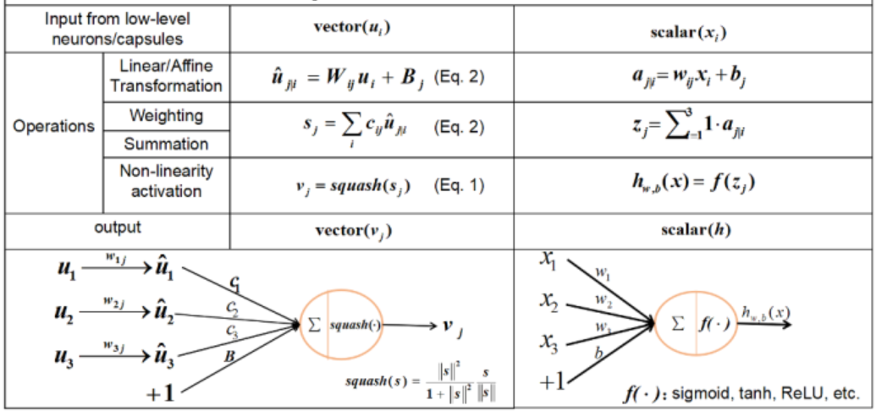
Capsule vs. Traditional Neuron

Slide 7
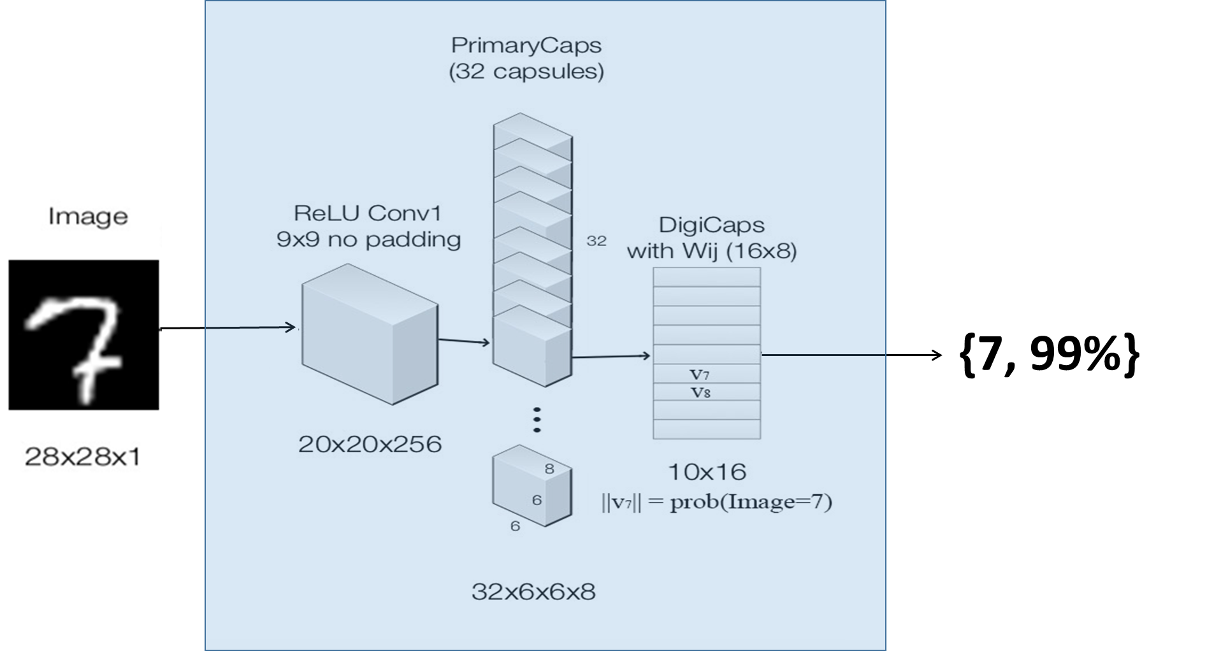
Capsule Network written for MNIST
(based on paper by Hinton et., al.)
Level 0 Capsules
Level 1 Capsules

Slide 8
Dataset
MNIST Handwritten Digits
Train set – 60000 examples
Test set – 10000 examples
Additional 500 images generated for testing, with following operations
Rotation Operation:
Overlap Operation:

Slide 9
Test Setup
Test Dataset
CNN
HNN
Compare

Slide 10
Results

Slide 11
CNN:0
HNN:0
CNN:0
HNN:0
CNN:0
HNN:0
CNN:0
HNN:0
CNN:0
HNN:0
CNN:0
HNN:0
CNN:4
HNN:0
CNN:2
HNN:0

Slide 12
CNN:1
HNN:1
CNN:1
HNN:1
CNN:1
HNN:1
CNN:1
HNN:1
CNN:7
HNN:1
CNN:2
HNN:1
CNN:3
HNN:1
CNN:1
HNN:1

Slide 13
CNN:2
HNN:2
CNN:2
HNN:2
CNN:2
HNN:2
CNN:6
HNN:2
CNN:0
HNN:2
CNN:0
HNN:0
CNN:0
HNN:6
CNN:6
HNN:6

Slide 14
CNN:3
HNN:3
CNN:3
HNN:3
CNN:1
HNN:3
CNN:2
HNN:3
CNN:0
HNN:2
CNN:3
HNN:3
CNN:7
HNN:3
CNN:1
HNN:3

Slide 15
CNN:4
HNN:4
CNN:6
HNN:4
CNN:1
HNN:4
CNN:1
HNN:4
CNN:4
HNN:4
CNN:4
HNN:4
CNN:7
HNN:7
CNN:1
HNN:1

Slide 16
CNN:5
HNN:5
CNN:5
HNN:5
CNN:5
HNN:5
CNN:2
HNN:2
CNN:0
HNN:6
CNN:4
HNN:6
CNN:5
HNN:5
CNN:2
HNN:9

Slide 17

CNN:6
HNN:6
CNN:6
HNN:6
CNN:0
HNN:0
CNN:0
HNN:0
CNN:9
HNN:9
CNN:4
HNN:6
CNN:6
HNN:6
CNN:0
HNN:6

Slide 18
CNN:7
HNN:7
CNN:7
HNN:7
CNN:7
HNN:7
CNN:7
HNN:7
CNN:4
HNN:9
CNN:6
HNN:7
CNN:0
HNN:7
CNN:1
HNN:7

Slide 19


CNN:8
HNN:8
CNN:8
HNN:8
CNN:0
HNN:8
CNN:8
HNN:8
CNN:6
HNN:8
CNN:6
HNN:8
CNN:8
HNN:8
CNN:6
HNN:8

Slide 20
CNN:9
HNN:9
CNN:9
HNN:9
CNN:9
HNN:9
CNN:4
HNN:9
CNN:0
HNN:9
CNN:0
HNN:9
CNN:9
HNN:9
CNN:2
HNN:9

Slide 21
Observations
Longer training duration compared to CNN
Further investigation and optimization required

Slide 22
GitHub
https://github.com/sureshsugumar/HierNet

Slide 23
References
Concept inspiration –
Sara Sabour, Nicholas Frosst, Geoffrey E Hinton. Dynamic Routing Between Capsules. arXiv:1710.09829, 2017.
MNIST Video generation – http://blog.otoro.net/2016/04/01/generating-large-images-from-latent-vectors/
Demo inspiration – https://github.com/lexfridman/mit-deep-learning/blob/master/tutorial_deep_learning_basics/deep_learning_basics.ipynb

Slide 24
Project Demo

Slide 25
YouTube Video
https://youtu.be/TL81fI0X6vg

